Slide 1
Products Practice

Slide 2
Products Data
[
{category: "Sporting Goods", price: "$49.99", stocked: true, name: "Football"},
{category: "Sporting Goods", price: "$9.99", stocked: true, name: "Baseball"},
{category: "Sporting Goods", price: "$29.99", stocked: false, name: "Basketball"},
{category: "Electronics", price: "$99.99", stocked: true, name: "iPod Touch"},
{category: "Electronics", price: "$399.99", stocked: false, name: "iPhone 5"},
{category: "Electronics", price: "$199.99", stocked: true, name: "Nexus 7"}
];

Slide 3
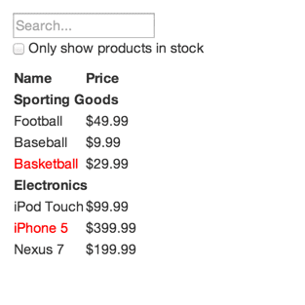
UIX Requirements

Slide 4
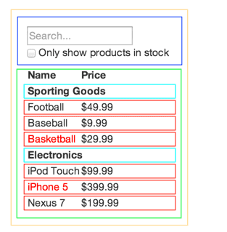
Splitting Component Responsibilities
FilterableProductTable
contains the entirety of the example
SearchBar
receives all user input
ProductTable
displays and filters the data collection based on user input
ProductCategoryRow
displays a heading for each category
ProductRow
displays a row for each product

